Slide 1
Dr. Frank D. Gorrez Volunteered to Shalom Science Institute In Lanao del Sur, Mindanao, 2016 - 2019
In 2017, SSI is served by a 15-member board of trustees and administrative officials including a president, executive vice president, and a principal. It was registered with the Securities and Exchange Commission when it attained its high school status in 2010. Eufemia served as voluntary president.
SSI is relegated to DepEd’s Tract 3 – Vocational/Livelihood due to the fact that not all teachers have teaching licenses. This drastic change was in SSI’s favor, as it forced SSI to evaluate programs and implement those that can realistically prepare students for a better future. “We decided to start agri-business,” said Eufemia. She was in a quandary. “How? Where? What? Who?”
The answer came – in the person of Dr. Frank Gorrez, a retired international agronomist, who volunteered to spearhead SSI’s agri-business project. His expansive experience as consultant to World Bank, the UN, UNFAO, USAID, and church organizations in 16 countries for 45 years served SSI‘s and the agriculture community much needed new ideas.
Frank had read about SSI in Eufemia’s Linkedin Profile and the convergence of his thought to be of service and SSI’s need for help met in his book, “Grow Paddy Rice Successfully.” What SSI would ultimately become is a “Light in the Crossroad” of DepEd’s education overhaul, specifically for Tract 3 senior high schools, said Eufemia.
In her report, Eufemia said four months after Frank entered the scene, she stood in awe “gazing at a green landscape of rice and vegetables on a corner lot across the street from SSI; what four months ago was a pasture land, dump site, and abaca dryer has become the ‘talk of the town’ – a visible testimony to the miracle of planting seeds and now, a bountiful harvest of rice and vegetables.”
SSI’s Rice and Vegetable Garden (RVG) has become the “Light in the Crossroad” whose beam “has reached far and wide and many a curious person look in amazement and admire. RVG speaks volumes for what it has become through growing different varieties of rainfed rice and multi-cropping of vegetables, she said. “What is very interesting is the idea of multi-cropping, thus RVG remains green throughout the year all the time,” wrote Eufemia. RVG has also started planting corn, radish, pechay, kalabasa, string and winged beans, tomatoes, green chili, ampalaya. Multi-cropping is skillfully crafted by Dr. Frank. In a sort few months, donations poured in. “His contribution to SSI, the community, and beyond is measureless. What a blessing he is!”
In April-May 2017 in the midst of the ongoing Marawi war, Mayor Nhazruddin Maglangit, Al Hadj with his agricultural staff in Kapatagan municipality, Lanao del Sur, visited SSI and invited Frank to extend the SSI-3TS Development Program Assistance to 15 barangays of Kapatagan, under his administrative jurisdiction. There Frank, then SSI consultant and Board of Trustees member, conducted workshops and distributed free rice seeds to 84 farmers. Palay seeds were harvested from SSI’s Rice and Vegetable Garden. SSI felt proud to assist the farmers by giving them free seeds. Then Frank conducted a seminar-workshop in the municipality of Rajah Buayan, Maguindanao under the sponsorship of Gawad Kalinga/Konomics, on March 22-24 this year.
Reported Eufemia: “Shalom Science Institute’s RVG is bridging the gap between Christians and Muslims through students’ participation, community awareness, free distribution of palay and vegetable seeds. We at SSI are very fortunate and grateful to Frank Gorrez, who, like a stone dropped in a pond, ripples of his work are reaching out to the needy and to a local plantation owner.” People whose lives were touched by Femme’s generous and caring spirit are saddened by the news that she passed away at home on June 22 in Medical Lake, WA. (Excerpts from Domini Torevillas’ Article – PhilStar Columnist)
--------------------------------------------------
From: E. C. Kho
Sent: Wednesday, June 27, 2018 10:59:58 AM
To: Frank Gorrez, PhD; Gideon Alegado, Dr.; Rolando Del Carmen, LLB. Dr.; Atty. Samuel Buot; Ester Amante; Norma Belloso- Strong; ophelia Recla Pantejo, RN, BSN;
Fele Magdamo, BSN, RN; Silliman Office of Information and Publication; Silliman University; Erlinda Demeterio; Eleanor Funda-Sardual; Benjamin Malayang III
Subject: Photo Album--SSi & E.T.M.

Slide 2
Dear Dr. Gorrez,
It is my honor to address you. Your notable achievements are well-known; your excellent work at the Shalom Science Institute (SSI) as a volunteer consultant in agri-business has been praised by the SSI President Mrs. Eufemia “Femme” Tobias-Munn time and again. And now that she is gone, your Photo-album of SSI--personnel, physical lay-out, agricultural output, and students—is a visual testament of the legacy of Mrs. Tobias-Munn. Thank you for this visual record of SSI, and for your valuable contributions to SSI in their agri-business undertaking.
I had the enviable experience to know the Bishop Proculo Rodriguez family: Portia was my high school section-mate; we graduated from HS together in 1952; she is a very good friend. I knew her brother, Proculo, Jr. and her sister who later became your wife. The Rev. Ely Mapanao was my college Algebra classmate; he wed Portia later. I attended the Ellinwood-Malate Church when Ely was Pastor there and interacted with them during Sunday worship and in other venues.
I have made donations to the SSI. In my recent tribute to Femme, I stated that we should memorialize her legacy and her life core values by seeing that the SSI can continue its vital function in bridging the gap between the Filipino Christian and Muslim populace. The resultant national unity is very vital to the very existence of the Philippine Republic. One can imagine the impact of one Silliman University alumna—Mrs. Eufemia Tobias-Munn-- on the future stability of Filipino nationhood!
My plea to all Filipinos, Fil-Ams and their friends is to continue to support SSI today and henceforth, for the good of the Republic.
~Eusebio C. Kho, M.D., Diplomate, American Board of Surgery Colonel, US ARMY (Ret.); Veteran, Op. Desert Storm Outstanding Sillimanian Award (OSA) in Medicine, 1989
Order of Horace Brinsmade Silliman Award, 2010, Scottsburg, Indiana
---------------------------------
From: E. C. Kho <sebkho@hotmail.com> Sent: Friday, June 22, 2018 10:54:09 AM
To: Emma Teves; Sam Buot
Cc: esther amante; Norma Strong; Ophelia Pantejo; Erlinda Demeterio; Fele Magdamo; carmen@buot.net; Ruby; Frank Gorrez; W. Llamera; Rolando Magdamo; Ben Cabral; Ruth Buot Yandell; Rev. Dr. Frederick Agnir; Benjamin Malayang III; Eleanor Funda-Sardual; Myrna Sweet; Dr. Angel Alcala,; Demy Navarro; Somera Frank; Gideon Alegado, Dr.; Hawthorne Ghent; Rolando Del Carmen; Myrnabarinaga
Subject: Re: Femme Munn
To the World-wide Silliman Family:
Words cannot adequately describe our sense of profound loss with the passing of Mrs. Eufemia "Femme" Tobias-Munn at her home in Washington State.
She is truly a patriot of the Philippines and of the country she adopted, the USA. She has served both with dedication and zeal. Her most significant contribution to Philippine unity as undivided nation is her avowed aim to heal the religious divide between Christians and Muslims. Thus was born the Shalom Science Institute where young Filipinos from both cultures are taught to learn, play, pray and dine together in common pursuit of educational enlightenment. She has fought hard for funding for this school she built in Balabagan, Lanao del Sur from foundations and private donations.
She is indeed a woman with a heart of gold and good intent for Philippine unity. To keep faith with her noble aims, let us memorialize her life core values by continuing to support the Shalom Science Institute today and henceforth.
Grace and I pray that God takes her into the eternal home in heaven for the faithful, where she will dwell in perfect peace, total joy and sublime life for eternity. We also pray that God bless her earthly family.
~Eusebio and Grace Kho
----------------------------------

Slide 3

Dear Lisa, (Daughter of FDGorrez residing in Australia)
Let me share with you a very, very private thought: Your dad is an answer to earnest prayer for SSI.
I came home May. 2015 from SSI, perplexed but undaunted on what we have decided... to offer an agri-business, one subject in Dept. of Education's senior high curriculum. It took the long flight from Manila to Seattle for me to earnestly pray and just surrendered SSI to God. I said, "If it is your will, send us someone to help us."
June and July 2015, I focused on finishing the memoir of a 96 year-old WWII veteran, and Aug. 4, I submitted the manuscript to the publisher. Aug. 22 on LinkedIn Frank said he had read my profile and is curious about this small school in Mindanao, that he had written a book on growing rice and offered to help shape the financial status of SSI.
Retired comfortably in Manila and with two pages of "accomplishments" in his bio data there was no way I thought Frank Gorrez would consider coming to a very remote town in a Muslim area.
I asked God, "Is it Frank Gorrez? If it is, then I will gladly follow your lead and make this happen." I had heard of his name only from Nonon and Josue Rodriguez who were my neighbors in Silliman University campus.
I attended the June 15 meeting in Manila that Frank organized in Valle Verde 5. The rest is history. I had never worked so hard mentally and physically than in those 4 months in SSI trying to absorb what there is about agri-business, a brand-new endeavor for me, listening, learning, and working with this walking textbook. The "3TS" program that Frank is implementing is the present and future survival of SSI, and I am right there to ensure that he gets full assistance and support from us.
"God's ways are as mysterious as the pathway of the wind." I pray and thank HIM incessantly for sending Frank to us to a mission which has now become a beacon of light, a "A Light in the Crossroad" that beams far and wide. It is making a difference in the community and the Rice/Veg Garden (RVG) speaks volumes.
Thank you so much for your support.
Aunty Femme
Medical Lake, Washington State
--------------------------------------------
From: "Bruce Tolentino (IRRI)"
To: "Frank D. Gorrez"
CC: IRRI Marco Vandenberg, Gurdev Khush, Chito Protacio
Hello Frank -
Amazing - and a blessing, that you have continued to serve in the area, seeing what is happening now in Lanao Del Sur.
PhilRice will be thrilled to hear of your results. May I encourage you to visit with PhilRice, and offer to speak of your experience and discuss ways to further and more widely deploy the varieties you found useful?
Cheers Bruce
Bruce J. Tolentino, Ph.D.
Deputy Director-General and Secretary, IRRI Board of Trustees
+63 (2) 580-5600 extn 2705/2213
+63 (917) 812 4383 (mobile)
b.tolentino@irri.org www.irri.org; skype: vbjtolentino

Slide 4




FOOD & AGRICULTURE ORGANIZATION COMMUNICATION
Dear Dr. Gorrez,
Thank you for sharing your experiences in conducting the Training and Techno-Transfer System (3TS) in Mindanao.
It is good to know that you have been part of some of the projects supported by the Food and Agriculture Organization and we will explore opportunities where we can tap your expertise in the future. While we already have your email address, you may also wish to provide us your other contact information and updated CV.
We appreciate your interest on how to support the youth and the local farmers in the country. We wish you success in this endeavor.
Best regards, Aristeo A. Portugal
Assistant FAO Representative (Programme) United Nations Food and Agriculture Organization 29th floor, Yuchengco Tower
------------------------------
WORLD BANK
Edgardo Quisumbing (retired World Bank Staff) You are doing exemplary work Frankie. I’m proud to be your brod. More power to you.
Keep safe in Lanao Sur.
Orlando Sacay
Well done, Frank.
Basilio de los Reyes: Well said. This is just the beginning of a long process so that lasting peace will prevail in Mindanao. ----You can contact me: gasapous@yahoo.com or cel no 63 9399296352 (World Bank retired technical staff).
_____________________________________
to Frank Gorrez August 16, 2017 ·Dr. Frank Gorres Thanks for our message. Please send me your e-mail and mobile/Viber number. Regards. Gov. Daof, My email is <gorrez.frankd24@gmail.com> and CPhone is <09954491615> . The honorable Dr.Saeed Daof is currently with the Philippines National Red Cross in that capacity as Governor of the organization. Saeed Daof Delivering a message about the Mindanao peace process as Vice President for Mindanao and concurrent Chairman of the Peace and Development Committee of the Philippine Constitution Association (PHILCONSA)
----------------------------------------------------
JoAnn de Larrazabal February 18, 2017 ·
The first 11 yrs of my life were spent in UP Los Baños when my dad Frank Gorrez worked at the
International Rice Research Institute (IRRI). After that, the family left for the Solomon islands (South Pacific) where we lived for 4 yrs., I studied in Australia, moved back to Manila. In the meantime, Dad (an agriculturist) & Mom, went on to work in Nepal, Rome, Belize, Nicaragua, USA...finally ending up with my family in Manila 12 years ago. Four yrs ago, I organized a reunion of...February 18, 2013The old folks were so happy!
Frank Gorrez July 15, 2017 ·
During the siege in Marawi, Mindanao exchanging bullets & bombs, SSI with Consultant Frank Gorrez exchanged knowledge, technology & hands-on demonstration by implementing a "Rice & Vegetable Garden," for the farming communities in the Municipality of Balabagan and Kapatagan, Lanao Del Sur.
-------------------------------------

Slide 5
Ravindra Joshi Frank Gorrez we all have a lot to learn from you. Your contributions globally are exemplary. Hope to visit you one of these days. God bless you. Warm regards.
________________________________________
From: Dr. Ben III Malayang (Former Sec. of DENR & Former Pres. of Silliman University)
Manong Frank:
What you’ve done is praiseworthy. SSI may be a small school in a small place, but with your advise and direction, it is showing a great thing about what we could do with what we have, to better secure our food security and future. I don’t think there is much more that I or anyone else could add, except perhaps one thing — about possibly incorporating in the RVG a fisheries component. Perhaps have some fringing ponds to collect rainwater, and to host fisheries that could provide the protein complement of the RVG? A recent paper had shown that among the zoological sources of protein, fisheries appear to offer the best micronutritional profile.
Would you be open to possibly brief DepEd Sec Briones on SSI as a model of countryside schools, and of agriculture as a locus of science learning? I really think it’d be swell to mainstream the SSI education pedagogy. Just my take.
Thanks, Manong, for allowing me to comment on this.
Ben III Malayang
-----------------------------------------------------------------------------------
Shalom Science Institute was too short a period for me and not to share the world of joy Femme showed in her daily learning-venture in the world of agriculture. SSI during this agri-development period was inspected by DepED and has greatly contributed to SSI's approval to prepare for the senior year registration. Approval for funding scholarship for grades 9 & 10 by the government was approved. I'm happy for Femme.
------------------------------------------------------------------------------------
GKonomics September 20 at 2:00 AM ·
Frank is 87, Bayani is 80, and Antono is 78. Old age has not deterred them from being part of GKONOMICS efforts in promoting countryside development through social entrepreneurship. Dr. Frank Gorrez is a retired agronomist who consulted for over 20 countries around the world and who is now sharing his expertise with GKONOMICS in developing a pathway model for sustainable countryside development though his rice vegetable garden template which he started in Lanao del Sur. Dr. Antonio Bautista is a poultry expert mentoring GKONOMICS RHI Farm Poultry Caretaker Tata in operating the poultry social enterprise in Batangas.
Bayani Cabrera is a retired pharma sales executive living in Los Angeles, California who is now helping as an angel investor in a GKONOMICS agri-business in his native province Batangas with Bayani’s Chickens, as part of his longtime dream to be a farmer.
Thank you Tito Frank, Doc. Bautista, and Tito Bay for helping us have sustainable social enterprises! January 25, 2018 ·
According to the National Anti-Poverty Commission, Lanao del Sur is the poorest province in the Philippines … but its land is very rich and fertile. Top agronomist Dr. Frank Gorrez has been spending time in Lanao del Sur in the last two years establishing proof of concept of successful agri-preneurship in partnership with a private Christian-Muslim school called Shalom Science Institute in Balabagan, Lanao del Sur.
According to the National Anti-Poverty Commission, Lanao del Sur is the poorest province in the Philippines … but its land is very rich and fertile. Top agronomist Dr. Frank Gorrez has been spending time in Lanao del Sur in the last two years establishing proof of concept of successful agri-preneurship in partnership with a private Christian-Muslim school called Shalom Science Institute in Balabagan, Lanao del Sur.

Slide 6
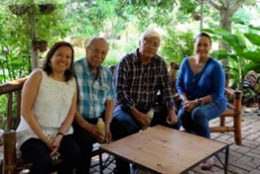
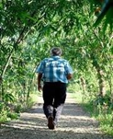
In a 4-month period, with minimal resources, Dr. Gorrez implemented the Rice & Vegetable Garden (RVG) project and was able to help the community produce a variety of rice and vegetables using the idle land that used to be unproductive behind the SSI school. The average monthly salary of a teacher in the area is P5,000. Supplemental income coming from growing vegetables and producing value-added products will go a long way in raising the standard of living of the poor families in the town.
In the last 12 months, GKONOMICS has been exploring with Dr. Gorrez, the school owner Eufemia Munn, and now with Mitch Genato of Life Sciences how to sustain, scale, and replicate this admirable and well-intentioned effort in more poor towns in the Mindanao.
Life Sciences is a wellness company that offers an advanced approach to health and wellness through their patented system. Life Sciences' holistic program advocacy and functional medicine program are very closely tied to organic vegetable production. Continuing dicussions as facilitated by GKONOMICS may hopefully lead to a sustainable partnership where the poor communities of Mindanao could be producers of organic vegetables and value-added products that align with LIfe Sciences' plans.
Among ideas being explored is a vegetable noodle production facility in the Balabagan area that could provide livelihood to some people in the area and produce healthy innovative products that could sold in the surounding areas. GKONOMICS enterprise coordinator and Project Mushroom/ GuLife pasta entreprneur, Ryan Apinado, is prepared to go to Lanao del Sur and help set up a community-based social enterprise there related to vegetable farming and value-added production of healthy products.
The RVG enterprise is work in progress as funding challenges have arisen but everyone is hopeful that the planned visit for enterprise development and entrepreneurship training by GKONOMICS to Lanao in the next few months will materialize somehow.
Ideas and collaborative efforts are most welcome!
-----------------------------------------------------------------------------------------
Visit to Gawad Kalinga in Bulacan.
JoAnn Gorrez de Larrazabal shared Gawad Kalinga’s photo.
December 13, 2016 · Frank Gorrez Visit to GK Enchanted Farm in Bulacan. "This afternoon could be captured in just one word: LOVE." - Dr. Frank Gorrez "Thank you very much for such a rich and meaningful experience this afternoon. With Rose Isada Cabrera, Frank Gorrez & Gawad Kalinga's founder TONY MELOTO & JoAnn de Larrazabal.
An enriching trip to GAWAD KALINGA Enchanted Farm in Bulacan yesterday. Thanks Rose Isada Cabrera, for inviting Dad .
It is very uplifting to hear stories of empowerment and hope for the poor. Together with Rose's class in Social Entrepreneurship of STC - QC, we heard stories from children of basureros, tricycle drivers, orphans who are now scholars of GK School for Experiential & Entrepreneurial Development. No longer the rejects of society, these young people have started up businesses raising free-range chicken, duck, quail & turkey raising, juice from oregano, peanut butter, stuffed toys and more, and living in a decent home. These people have found their worth which makes them priceless. GAWAD KALINGA'S mission is 'Building communities to end poverty’.
August 7, 2016 ·
Jo Ann de Larrazabal. So proud to share our 84 yr. old dad, Dr. Frank D. Gorrez, with the Shalom Science Institute (SSI) in faraway Balabagan, Lanao Del Sur in Mindanao. He has set up a Rice Garden & Gulayan sa Paaralan (Vegetable growing in School). A Rice expert for 50+ years, he is sharing his expertise in SSI, a Christian school, within a predominantly Muslim population. An enriching trip to GAWAD KALINGA Enchanted Farm in Bulacan yesterday. Thanks Rose Isada Cabrera, for inviting Dad and I. It is very uplifting to hear stories of empowerment and hope for the poor. Together with Rose’s class in Social Entrepreneurship of STC - QC, we heard stories from children of basureros, tricycle drivers, orphans who are now scholars of GK School for Experiential & Entrepreneurial Development. No longer the rejects of society, these young people have started

Slide 7

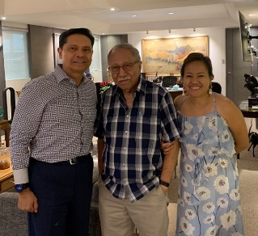
Redempta Hofer
Ok Manong Frank magtrabaho guid kami para sa SSI. Tungod sa inyo nga mga advices kag inspiration amo guid nga tabangan ang school, labi na guid ang pag prapare sa mga documento para sa ESC para sa ila nga pagbisita
Hello Manong Frank, mag pray gyud kami nga maayo guid lang ang results sang imo nga examination. We love you Manong Frank
Increase in enrollment
July 3, 2017 · School closing is just a step to next school year --- enrollment 7/3/17 K-Gr.10 soared to 292, an all-time high! Ripple effect of Consultant Frank Gorrez work is making a big difference in a school where the sea meets blue skies in endless horizon. Eufemia Tobias Munn
July 21, 2017. pasalamat pud kita sa ginoo manong frank kay naga increase atong enrolment yearly maskin wala kita scholarship offer sa high school for two year na pero good news kay atong population both elementary and high school increase. karon nga tuig nag increase atong population total population elemetary and high school 312. Jennifer Mendoza
-----------------------------
July 3, 2017 ·
He lit up the campus and brought sunshine to everyone. — with Frank Gorrez, Zowie Luz T. Magno, Maricel Calo Tanhente, Lady'jane Quiatchon and Maria Cristina C. Talorete.
Sa July 21 manong frank naa pa me buhaton nga tribute kay mam fem kay mao kana ang foundation day sa shalom.I reallt admire mam femme how strong woman she is manong frank..I am very much thankful that i am part of shalom family because of mam fem kay with her initiative di ko bal an asa ko karon naka work ug daghan ako nakat-unan sa iya manong frank.
pasalamat pud kita sa ginoo manong frank kay naga increase atong enrolment yearly maskin wala kita scholarship offer sa high school for two year na pero good news kay atong population both elementary and high school increase. karon nga tuig nag increase atong population total population elemetary and high school 312.
Jennifer (SSI-Academic-in-charge)
---------------------------------------------------------
Leonardo David
January 1 at 11:51 AM
Every betans are so proud of you brother.
----------------------------------------------------------
Frank Gorrez Thank you, brod. I wish more members will think of others in need and help carry their load.
Eileen Bennett Amazing indeed..What's the secret with such an awesome crop, Mr G?❤👍
GKonomics added a new photo.
July 19, 2019 ·
They are innovative social enterprise initiatives with CIto Lorenzo as partner. Mr. Lorenzo is a GKONOMICS mentor and Council member. Shown here with him are GKONOMICS agronomist consultant & partner, Dr. Frank Gorrez, and Executive Director, Rose Cabrera .
— with Rose Isada Cabrera and Frank Gorrez.

Slide 8

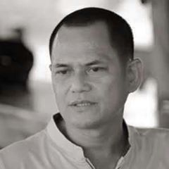
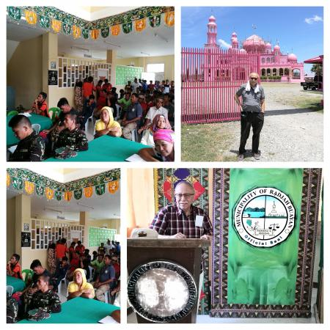
Greetinds, Mayor Zamzamin. I'm Dr. Frank Gorrez who conducted a seminar-workshop in your Buayan Municipality sponsored by Gawad Kalinga Mindanao with support from Datu King Ampatuan. This was about the Rice & Vegetable Garden implemented in Shalom Institute in Balabagan, Lanao Del Sur. Wishing you good health.
Zamzamin Lumenda Ampatuan. September 13, 2019 ·
salam kanu imam tanu a gay na gyamat i kambwat nin... Endu salam kanu nabi eesha a.s. a mapaylay bpaluman sa gay na gyamat...salam kanu mga mumineen... salaam mga lukes ko mga kaka ko mga suled ko mga pakiwatan ko...
semalawat tanu... ALLAAHUMMA SALLE ALAA MUHAMMAD WA AALE MUHAMMAD
Marita MG Dalamban Alaykumissalam datu mayor
Rasul Lumenda UtapMay Allah have mercy on you, God's willing.
Malimu Masapakat Pan ASAMWAM☝
74Ahmed Acob Sali, Adjezz Angas and 72 others

Slide 9


Slide 10
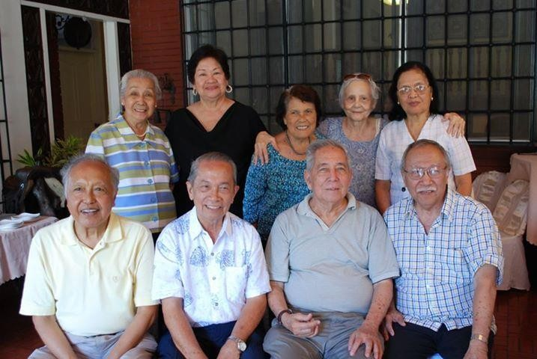

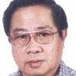

I visited with my colleagues at UPLB in Los Banos some years back after being away for 40 years on foreign consultancy work.
(Seated left to right) Tito Contado, Cezar Mamaril, Ramon Valmayor, Frank Gorrez. Standing: Mercy Drilon, Jophine Lazaro, Nenita Mamaril, Eppie Gorrez & Helen Valmayor.
Noel Razon Miciano Life has been great overall to you Frank Gorrez. And let me say that the best way to measure success in a career is by how much people and communities have benefited from the work one had done ( in your case, that you continue to do). Back then when Umali Subdivision was still a starting community and you call every other's father "Uncle". It is then now a privilege to have an "Uncle" like you.
NATIONAL SCIENTIST PLANT BREEDER, UNIVERSITY OF THE PHILIPPINES AT LOS BANOS
Celso Lantican Frank Gorrez sent the following message at 6:07 AM. Happy birthday! Celso from Frank Gorrez. Thank you Frank! It's a great feeling to be greeted by a friend like you. Hope you are well. Cheers! Celso
--------------------------------------------- Chito Protacio
to me, marsaspiras, Edgardo, Saeed, Sailila, Jose, Eufemio Rasco FORMER DIRECTOR of the PHILIPPINES RICE RESEARCH INSTITUTE (PHILRICE) Impressive work, Brod Frank. You need new recruits in this war of yours. Chito-74e ----------------------------------------- Batcom Ely Brod, paano kaya kami maka access ng rainfed rice variety nyo dto sa Oriental Mindoro? Sana pala makita ng Department of Agriculture at DepEd ang ginagawa nyo sa SSI para maging huwaran sa ginagawang Philippine Rice Road Map na kung saan maisama ang technology na isa sa strategies? Mabuhay ka Brother! ----------------------------------------- Cezar Mamaril (Retired IRRI Soil Scientist) _____________________________ Brod Frank, the people there in Lanao should make you Datu Frank for doing such splendid work of uplifting the l livelihood of the people there. More power to you Brod. ------------------------------------------------ Sam Buot (USA) Great job Frank. Thanks for helping in carrying out Femme's dream. Betsy de la Fuente Wow! Huge! Looks good, Tito! You’re the best! Love you! Frank Gorrez Love you, Betsy. Marcelo Aspiras You look great Frank, my energetic Brod! Will never forget our UPLB days during the early 50s, specially your role in several musical presentations such as South Pacific (Some Enchanted Evening, etc.) and Jim Brewbaker's choir. More power to you Brod. Frank Gorrez Thanks Brod Cel. So glad to hear from you. Send me your email … mine is gorrez.frankd24@gmail.com Beatriz Mete God loves you and so do we!
---------------------------------------- Tony Mabesa, Feb. 4, 2019: Tony Mabesa was the lead actors of RAINBOW'S SUNSET with Gloria Romero. Eddie Garcia. A dream cast... You’re doing an admirable job Frank. MU Sister Tenny wife to Jun Vega Will turn 87 come May. How’ your Brother Danny ? You & your brothers were the toast of UPLB in the fifties. Excellent Singers.

Slide 11
Manong Frank,
We really cannot thank you enough for all you've done to help SSI, especially in bringing it to the level that it is in now. Certainly, the founders, the late Dr. Mert and my sister Mrs. Femme Munn are ever proud and thankful for your great contributions. We thank the Lord for leading you towards SSI which has benefited (and will continue to benefit) many families, the community, and the country.
(Auntie/Mrs.) Rachel T. Alegado and Dr. Gideon "Kuya Box" Z. Alegado Shalom Science Institute
Overseas Office
(Mrs.) Rachel Tobias Alegado, MS, Acting President 2428 NW 11th Street
Corvallis, OR 97330
Phone: 541-230-8448 Email: <gxalegado@gmail.com
----------------------------------------
LIGHT IN THE CROSSROAD
From: Eufemia Munn <eppieph2002@yahoo.com> Sent: Saturday, October 22, 2016 5:25 AM
To: W. Llamera; Esther Amante
Subject: Fw: September Rice & Vegetables at Balabagan, Lanao Del Sur
Hi Win and Tellie,
This pictorial report of Frank would be of interest to you, including free arroz caldo to 241 Kindergarten to high school with funds donated by an NGO of Filipino Stewardesses of Cathay Pacific based in Hong Kong.
Frank is a God-sent person to SSI! Within 4 months much has been accomplished. The Rice and Vegetable Garden has become a beacon of light, a "Light in the Crossroad", the topic of my Sunday message in Church. The light beams to the community and beyond. Free distribution of palay-rice seeds and vegetable seeds to parents, schools, and farmers in the area has caught like wildfire.
PhilRice gave SSI 8 varieties of upland rice to see which best fits the area. Seeded on July 1, we harvested two varieties last week. The miracle is: 1 seed produces 2,000! A handful seeded on July 1 produced a few kilos of seeds and given free to farmers. This empowers them to plant seeds for multiplication for their use, not dependent on government hand-out.
The beam has lighted on Jomar Lobregat, owner of huge plantation of cassava and coconut. He has started his rice production and a vegetable garden to replicate SSI's is now producing lots of vegetables - first sitao (beans) harvest was 17 kilos. He is planting SSI rice varieties (harvested this month) to 1/4 of his one ha. initial rice farm. His goal is rice mass production. The rest of this one ha. is planted with palay seeds that he bought in Midsayap, accompanied by Frank. While there they had lunch at Southern Christian College with its president and Portia Mapanao.
Frank has found his niche and is having a marvelous time teaching, producing, lecturing, gardening, and consulting. It has given him a new zest for living being able to help so many people, Christians and Muslims. Thank you so much Win, for your generous support of eight 7th graders for tuition and entrance scholarship. Kindly open attachments.
Femme
---------------------------------------------------------------------
Dear Femme,
Good day! How nice hearing from you again! Heartfelt gratitude to you for sharing with me the SSI-3TS Fourth Month Photo Report of international agronomist Dr. Frank D. Gorrez regarding the wonderful project he undertook in Balabagan, Lanao del Sur in cooperation with you and the Christian-Muslim institution you are running there, Shalom Science Institute.
What you and Dr. Gorrez did in Balabagan is rendering your knowledge and scientific expertise toward making this world better. I am including Dr. Ramon A. Razal of UPLB and Chair of the NRCP Division of Agriculture and Forestry in the cc line for his information. If you have news about Winnie Ruita Llamera, please inform me. My emails to

Slide 12
her are bouncing back.
Very truly yours, Les
Leslie Bauzon lebauzon@hotmail.com 31Oct2016
------------------------------------------------------------------------------
Dear Nitz,
Greetings from Medical Lake, Washington! I arrived two weeks ago from Balabagan, Lanao del Sur where I worked at Shalom Science Institute (SSI) since June. The K-12 DepEd education overhaul relegated SSI to Tract 3 - Vocational Livelihood, so we started an agri-business project. I will return to Balabagan in March.
Dr. Frank Gorrez, retired international agronomist prepared this "SSI 3TS 4-Month Pictorial Report. Please open attachment. Frank is the brother-in-law of late Josue Rodriguez of Silliman University and former President Ely Mapanao of Southern Christian College in Midsayap, Cotabato. Frank worked for UN, World Bank, UNFAO, USAID, and United Methodist Church in consultancy for 45 years in 16 countries.
Femme
-----------------------------------------------------------------------------
Dear Leslie,
"Those who are given much, much is expected," and you are surely that in academe and especially for and among the marginalized ethnic groups in our country. Your efforts are laudable and definitely makes you a role model to retirees. You and Dr. Frank Gorrez, international agronomist volunteer consultant at Shalom Science Institute are of a different breed of intellectuals.
Frank was a "missionary" agronomist consultant of the United Methodist Church, 475 Riverside Dr., NYCity to as far as Sumatra, Indonesia with Islam University. His coming to Balabagan, Lanao del Sur is not his first encounter with Muslims. In your inspirational message, you mentioned Filipino Muslims. Balabagan is 40% Christians and 60% Muslims. Frank fits very well in the community and has endeared himself to our Muslim brothers and sisters through his work. He was in consultancy with World Bank, UNFAO, USAID, United Methodist Church for 45 years in 16 countries. What we are doing is spread the word about Shalom Science Institute's "3TS" Rice and Garden program so that others may find a way to avail of such valuable teaching, thus, the 4-Month Pictorial Report that we shared with you.
You mentioned Camp Abubacar. I started in Shalom the day it was bombed in July 2000. Yes, I recall the insensitivity of people. Throughout SSI's 21 years existence from a small elementary to now with a junior high school, its mission is to bridge the gap between the two cultures through education. Prayer starts the day in every classroom. Students pray together, play together, and study together. A Board Member once said, "We cannot change attitudes of people" to which I responded, "Start with children. We may not see change in our lifetime, but this generation is given the opportunity to change with teaching of core values." SSI has made inroads in promoting peace, understanding, tolerance, and acceptance of differences. It is a choice school of many Muslim parents.
Thank you so much for your very eloquent inspirational message in Tawitawi! We used to have a resident in Oriental Hall from Bongao, a very amiable Muslim lady.
More power to you in your work!
Femme Munn
In Medical Lake
---------------------------------------------
Brod Frank Gorrez,
Great work, Brod! Service and sacrifice; you should be emulated by Betans.
Brod Chito Protacio
Former Director of the Philippines Rice Research Institute Nueva Ecija
----------------------------

Slide 13
Dr. Frank D. Gorrez
80 Celery St. Valle Verde 5 Pasig, Metro Manila Philippines
Dear Frank:
Greetings from Medical Lake, Washington State! It is a sunny and gorgeous Fall day at 62 degrees F, a welcome respite from sweltering heat and humidity in Balabagan. I just walked a mile along the lake, but no sweat... that I miss very much and in fact, I look forward to perspiration dripping down my face as early as 8:00 in the morning when I return.
I do not know where to begin this THANK YOU letter, but suffice it to say that there are never enough words to convey Shalom Science Institute's (SSI) gratitude to you. We at school have been complacent for many years that it took a mover and a shaker (and oh, a preacher) like you to come into our midst to show us that, "If you plant a seed, something will grow; that if you give, it will come back to you."
Your four months with us in Shalom Science Institute through the Rice and Vegetable Garden (RVG), not only provided physical improvements to SSI, but you have touched so many Christian and Muslim lives - students, parents, public schools, farmers, and neighbors. Your work has become a beacon of light, "A Light in the Crossroad," whose beam reaches far and wide, great and small. I told you right at the start that you work is like a pebble dropped on a pond and its ripples find their way to the end, and it did, even to a local plantation owner.
Through you, I would like to thank numerous supporters and donors of funds and in kind to SSI, without which four months of accomplishments would not have been possible: You, Jo Ann de Larrazabal, Amy Saxton, Liza Bauer, the Gorrez Family, Ike Araneta, Terry Manalo, Harry Yu, Kay Wong and her Cathay Pacific Stewardesses Friends, Sonny de la Fuente, Jeff and Cristy Hofer, Land bank, and LBC Foundation. And during the last two weeks here, Ruth Buot, Yandell and Warwina Llamera. Your pictorial reports are very effective and deeply appreciated by all of us.
You have touched so many lives in Balabagan and it is our fervent prayer that your mission in an area so remote and neglected will continue. We in SSI thank you so much for sharing your knowledge, talent, and expertise. What I see as a big difference is, you do not only give seeds, but you teach people what to do and how to do. You have given us "Bidlisiw sa Paglaom" - a ray of hope.
Blessings!
Eufemia T. Munn
President, Shalom Science Institute
------------------------------------------------
January 18, 2019 DR.YONGGYN KIM DR. BEN C. TOBIAS
Dear Dr. Kim and Dr. Tobias:
First of all, please allow us to thank you for your support and consent to pursuing the Farmers Training Center program. SSI is very thankful to Dr. Ben Tobias for translating the late SSI President Femme Munn's aspiration to have a Farmers Training Center in order to carry out her and her work partner, Dr. Frank D. Gorrez' dream. Dr. Gorrez and Dr. Tobias have been communicating with each other, and surely both of them are of one mind in carrying out the dream and aim of our dear departed sister, "Big Sis" in having such a program. Truly, SSI has become the beneficiary of the close friendship between Dr. Kim and Dr. Tobias. Most of all, we want to express our profound gratitude to TMTAN, Inc. for its kind and generous response enabling SSI to uplift the lives and spirits of many less fortunate people especially in the local and surrounding communities.
In my email to TMTAN, INC. and to you (Dr. Kim) on January 10, 2019, I mentioned that I have directed SSI administration to proceed with the infrastructure part of the FTC, and they will start the actual construction at the end of the current school year in April in order to avoid unnecessary accidents, not to mention the distraction and interruption of classes that the construction may cause or vice versa. In the meantime, all construction-related materials need to be purchased before they become very expensive to procure. As such, the SSI administration has been authorized to strictly follow the necessary procedures, and strictly observe and exercise faithful stewardship, including periodic progressive reporting. I hope that this satisfies the approval requirements.
Again, thank you very much, and may the Almighty continue to unite us even as, together or apart, we devote our utmost to His service.
Very truly yours,
Rachel T. Alegado
Acting SSI President

Slide 14
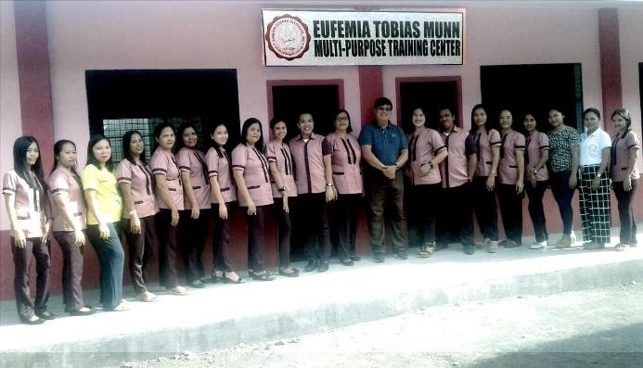
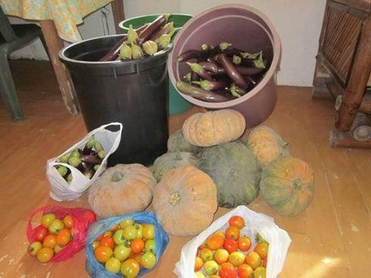
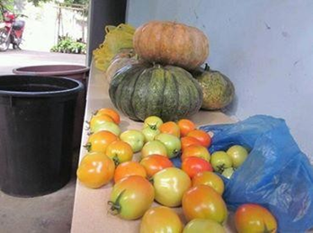
THE EUFEMIA TOBIAS MUNN MULTI-PURPOSE TRAINING CENTER WITH SSI FACULTY & STAFF
--------------------------------------------------------------------------
Ana Tirthdas It is good to know that your dad is part of the GKonomics. This is really the only way to fight poverty. To educate how one can be self-sufficient. Love your dad for still sharing his talents!
----------------------------------------------------
Rev. Sarah Harrison-McQueen
Frank,
wonderful to hear from you! What incredible work you are doing. Our lay leader, Dainty Ignacio, is from the Philippines and her husband, Don, does some work regarding deforestation. I will share your email with them because I think that Don would especially be interested to learn about this. I pray that God continues to use you to bless others and bring Glory to God every day! Thank you so much for sharing this with me.
Blessings,
Pastor Sarah Rev. Sarah Harrison-McQueen Senior Pastor
Central United Methodist Church
Bolston, Arlington, 4201 Fairfax Drive, Arlington, VA 22203 Email: pastor@cumcballston.org
---------------------------------------------
Corazon Pasaporte Horder So proud of your accomplishments Manong Frank. It shows how one person can make a difference. Shalom is so fortunate to have you! More power to you!!! hanks for sharing your gifts with the less fortunate, Frank. It is a great legacy.
Dolores B. Felicitas Nang Femme, what a great contribution you have given to the people in your community and what a blessing to have Manong Frank come to help you with agribusiness. May God continue to bless you with such a very laudable cause. You are a big blessings to the community. Congratulations!
"It only takes a spark, to get a fire going." That's what happened when Dr. Frank Gorrez, Consultant to Shalom Science Institute, spent the first 4 months in 2016. The "spark" is the Rice and Vegetable Garden RVG) and the "fire" is ripple effect that has touched the community. He lit up the campus and brought sunshine to everyone. SSI owes a lot of gratitude to this "messenger" of plant a seed and harvest comes.
The February 2018 on-going Rice & Vegetable Garden (RVG) implemented program is supervised by Geno Pasco Casan which started in June 2016 as a continuing SSI - school project with Grades 9 & 10 students participating.
Norma de Jesus So happy and impressed with these bountiful harvest. God is good to bring not only the right persons who have the proper knowledge & technology but also willing to share them with SSI personnel, family & friends of SSI. Femme, this would not have been possible without your love & selflessness to see this through in spite of your illness. Bless your heart. Praying that the Lord will heal your body and restore your health and strength. ❤️ ❤️ ❤️ 🙏🏼 🙏🏼 🙏🏼 🙏🏼

Slide 15

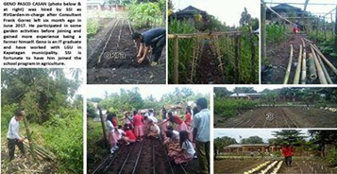
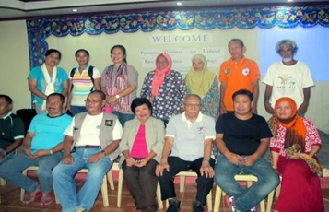

🙏🏼 🙏
Esther Tellie Amante I can't find the right words to describe this joint project of Frank and Femme.
Eufemia Tobias Munn Frank is an excellent teacher. What he tells us we do, so even in his absence, the project continues. RVG (Rice and Vegetable Garden) at Shalom Science Institute in Balabagan, Lanao del Sur is "light from the corner" whose ripple effect has gone beyond borders. Carved out of 500 sq. m. dumpsite on a corner lot, it had become a very effective demonstration of what can be grown in a small spot. Philippine Rice Research Institute donated different varieties of rainfed rice (palay) seeds to test and evaluate the best suited in the area. The choice varieties 4 months at harvest produced plenty of seeds, some which were given to 84 Muslim farmers in Kapatagan LGU, a partner of Shalom.
What is very interesting is the idea of multi-cropping, thus, RVG remains green all the time. This is skillfully crafted by Dr. Frank Gorrez, SSI Consultant who has volunteered to help SSI. In a short few months, donations poured in. His contribution to SSI, the community, and beyond is measureless. What a blessing he is! Our gratitude to Dr. Gorrez service which taught us how to start small; plant the seed and harvest comes.
Best Wishes,
Femme
---------------------------------------------------------------------
Frank Gorrez Good teachers are inspired by good students. Femme & SSI-RVG committee after two and going to three years (2016-2019) have shown no further need for a teacher. SSI-RVG can swim and not sink. The photos above and below were handiwork of teacehers, students & RVG in-charge, Geno Casan.
Frank Gorrez ... SSI Pres. Eufemia Tobias Munn commented on photos at left, "SSI is fortunate to have Geno as RVGarden-in-charge who took over at a very critical time."
Frank Gorrez Since I left in June 2017, Geno Pasco Casan took over
management and continued the "Training & Techno. Transfer Systems" RVGarden which was developed as a sustainable livelihood food program to show benefits for farmer's nutritional and income source. It is a hands-on demonstration program implemented through a school with teachers, students and farming community benefiting from its recommendations.
(Below) Frank Gorrez, Femme Munn, Jenny Mendoza, Jane Casan and Jo Leah Ferenal from SSI with Kapatagan Municipality LGU members.
Gorrez with LGU officers of Kapatagan Municipality and SSI staff with Agricultural consultant Dr. Frank Gorrez of Municipality, Lanao Del Sur - after conducting a workshop on rainfed rice production with farmers.
Cynthia Schubert Richmond shared Shalom Science Institute's
July 11, 2017 ·So very proud of my 86 years young uncle, Frank Gorrez. He doesn't know what retirement is
--------------------------------------
Eufemia Tobias Munn's post
School closing is just a step to next school year --- enrollment 7/3/17 K-Gr.10 soared to 292, an all-time high! Ripple effect of Consultant Frank Gorrez work is making a big difference in a school where the sea meets blue skies in endless horizon.
Jennifer Mendoza thank you manong frank for sharing your blessing with SSI family..
From: Jennifer Mendoza (SSI Academic-in-Charge). 21/07/2018. Sa July 21 manong frank naa pa me buhaton nga tribute kay mam fem kay mao kana ang foundation day sa shalom.I really admire mam femme how strong woman she is manong frank..I am very much thankful that i am part of shalom family because of mam fem kay with her initiative di ko bal an asa ko karon naka work ug daghan ako nakat-unan sa iya manong frank.
Pasalamat pud kita sa ginoo manong frank kay naga increase atong enrolment yearly maskin wala kita scholarship offee aa
high school for two year na pero good news kay atong population both elementary and high school increase. karon nga tuig (2018) nag increase atong total population elementary and high school 312.

Slide 16
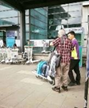
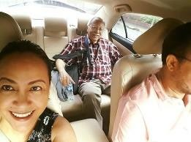
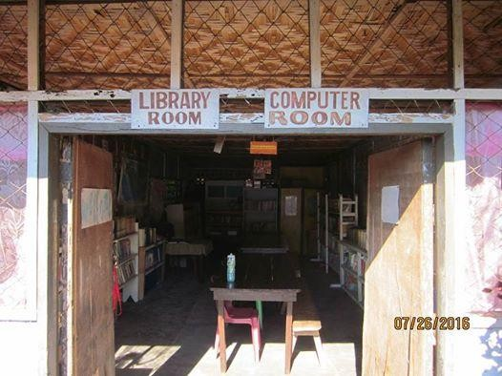
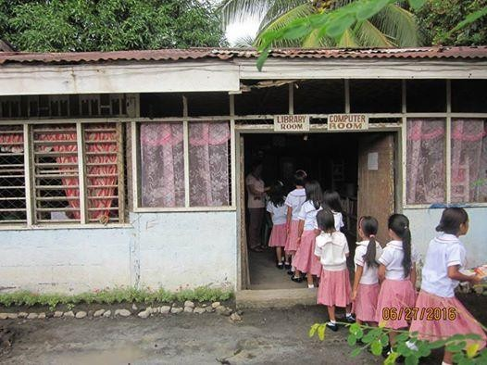
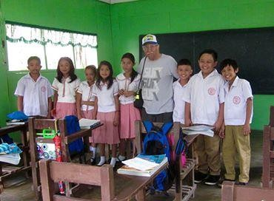
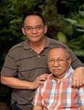

JoAnn de Larrazabal April 2, 2017 ·
This morning, we saw my daddy off at the domestic airport as he made his way back to his project. Am filled with gratitude that at his age of (almost) 85 yrs., he still has the energy, passion & the drive to do his life's work in agriculture. Sharing of his knowlege with our most needy & often neglected countrymen. Go dad!!! Frank
JoAnn de Larrazabal September 13, 2016 ·
HI FRIENDS!
SHARE YOUR OLD BOOKS AND CHANGE A LIFE! OUR CHILDREN IN MINDANAO, SHALOM SCIENCE INSTITUTE HAS A LIBRARY. THIS IS THE SAME SCHOOL WHERE MY 84 YR. OLD DAD HAS SET UP A RICE & VEGETABLE GROWING PROGRAM IN LANAO DEL SUR. THE ... Since arriving in Lanao del Sur, Mindanao, 2 months ago, Dad has set up the Rice growing and Gulayan sa Paaralan project for Shalom Science Institute (SSI). The rice and veggies are growing well and in a few months, harvest will take place. He has endeared himself to the students who fondly call him 'Datu Grampa'. Dad told me how the students are so eager to hear his stories about his world travels and work in different third world countries he... see more. THE LIBRARY WHICH IS BADLY IN NEED OF BOOKS. CHILDREN'S LEISURE READING BOOKS FOR AGES 5 YRS. TO 18 YRS. OLD ARE MOST WELCOME. PLEASE PM ME IF YOU WISH TO HAVE THEM PICKED UP OR DELIVER TO MY HOUSE. I WILL TAKE CARE OF
SHIPPING C/O A GENEROUS COURIER.
RVG has attracted people and organizations. The first one was Landbank and
Hofer Devt. Corp. which augmented SSI Library and made into a
"Landbank Library," the first in ARMM.
Gorrez is with Francis Gorrez and Frank Gorrez.
Happy Father's Day to the man who is always willing to sacrifice so he can give the best he could to his children; and to the father who taught and showed his son of how a father should be: Proverbs 22:6 "Train up a child in the way he should go, And when he is old he will not depart from it, loving our Lord that give wisdom and knowledge".
Marissa Jarmin Hartwig A beautiful person inside and out. You look like her in her youth. Such a sweet and gentle soul, an energy I sensed when we met briefly last year. She was a presence indeed. And now she is gracing the heavens with that brilliant smile. Prayers go out to you and the whole family. I hope to see you again this summer when I come home. Blessings always, JoAnn.
Eufemia Tobias Munn
RVG (Rice and Vegetable Garden) at Shalom Science Institute in Balabagan, Lanao del Sur is "light from the corner" whose ripple effect has gone beyond borders. Carved out of 500 sq.m dumpsite on a corner lot, it had become a very effective demonstration of what can be grown in a small spot. Philippine Rice Research Institute donated different varieties of rainfed rice (palay)seeds to test and evaluate the best suited in the area. The choice varieties 4 months at harvest produced plenty of seeds, some which were given to 84 Muslim farmers in Kapatagan LGU, a partner of Shalom.
What is very interesting is the idea of multi-cropping, thus, RVG remains green all the time. This is skillfully crafted by Dr. Frank Gorrez, SSI Consultant who has volunteered to help SSI. In a short few months, ,donations poured in. His contribution to SSI, the community, and beyond is measureless. What a blessing he is! Our gratitude to Dr. Gorrez service which taught us how to start small; plant the seed and harvest comes.

Slide 17

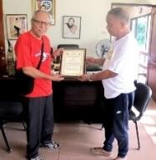




SSI Pres. Eufemia Tobias Munn, with students & teachers took six months to master non-stop "multiple Cropping Systems" from Consultant Frank Gorrez and has influenced farmers and even an entire municipality of Kapatagan, Lanao Del Sur led by their Mayor Nazzruddin Maglangit to evaluate in 17 Barangays (villages) the same technology for rainfed rice production with seeds coming from PhilRice, Nueva Ecija, Philippines.
Eufemia Tobias Munn SSI Consultant Frank Gorrez has brought light and energy to a campus that remained "stagnant" for years. There is a vibrancy now, not just in SSI, but in the community. He has endeared himself to the people and truly appreciate all the help he is giving... plant a seed in order to harvest. It has not been easy daily drill from this master gardener for six months, but SO MUCH APPRECIATED. And stewardship of that gift is what propels me to do the best I can in torrential rain, flooding, and sunshine. What has been imparted to students, teachers, farmers & farming communities was a lifetime knowledge that should be shared. The consultant's journey through valleys, mountains and rivers of life now shared in a silver plate (SSI-rvgarden) is God's gift through us all.
Dolores B. Felicitas SSI is a sample of how progressive this school is with the able support no less than from the expert in the person of Manong Frank who came to train students and farmers with no salary but pro bono. Nang Femme, you are a blessing to the people in Balabagan who sacrificed so much to impart and improve the life of the community. Congratulations to you both, Manong Frank and Nang Femme. God bless you!
Dr. Frank Gorrez receiving a Certificate of Recognition from Municipal Mayor Nhazruddin B. Maglangit, Al Hadj of Kapatagan, Lanao Del Sur, Mindanao in recognition of SSI & consultant's support to marginalized farmers in the municipality. Frank Gorrez Frank Gorrez received from Municipal Mayor Hon. Nhazruddin B.Maglangit, Al Hadj a Certificate of Recognition for conducting two seminar-workshop and distributing newly harvested in SSI-RVGarden selected rice varieties donated by PhilRice, Nueva Ecija, Luzon.
Frank Gorrez distributing free rice seeds for yield evaluation in 17 Barangay (villages) of Kapatagan municipality, Lanao Del Sur in Autonomous Region of Muslim Mindanao
Aman CarolinoGroup Admin Once again - proud to be a Betan because of amazing brods like you - Brod Frank Gorrez. More power to you !!! Cheers!
Rory Sta Catalina Dacumos More power to you Brod Frank!
Benjamin Albarece I'm a farmer myself, former LCE , and firmer Adviser to DA, brod Frank... I've seen the wide technology transfer gap brod. We need models. I do hope your efforts will be documented, especially the approach & its key ingredients aside from the technolog...
Bernie Bantegui Many of us hv retired. Thank u Brod Frank for being a living example that with our expertise and experience we cn still contribute to the community. We only hv to stay focused on what we want to accomplish and having a generous heart.
Joel C. Paredes Group Admin Brod, mabuhay ka!
Dave Ramos Proud to be a BETA SIGMAN! Proud to be your brod, Frank Gorrez UP College of Agriculture BETA SIGMA! Mabuhay#
Brod Vir Am a forester turned farmer now in my province. Am doing what a retired like me to the best interest of our farmers, who even did not go to college...brod vir fabian uplb72a
Dear brod,
Your reports & photos, nakakamangha ang powers mo after all these years. If we can approximate even half of that, the brotherhood would zoom to greater height, cheers to you!
jojo alfonso alejar/2016 oc.uplb@up.edu.ph Fernando Sanchez, Jr. Chancellor, UPLB
-------------------------------------------
Hi Tito Frank, Thank you for you have allowed the Lord to use you mightily to teach and continue to bridge the gap between Christians and Muslims. The perfect example of love. We are truly grateful and proud to have had the privilege to know you. Cristy Hofer

Slide 18

Dearest Tito Frank,
Thank you for sharing these photos of your experience in Balabagan.I will never get tired of being proud of you. I am sure the legacy that you have left with these people shall live in their hearts forever just like the Mayan Indians that you have taught to plant cacao. May the Lord continue to give you the strength to help the poor people of this earth.
Love you much Tito Frank.
-------------------------------------------------------
Cynthia Schubert Richmond
July 11 · So very proud of my 86 years young uncle, Frank Gorrez. He doesn't know what retirement is
_____________________________________
Frank:
I enjoyed seeing the work you did in Mindanao.
I give thanks for your dedication and effective work.
May God continue to bless you as you bless others with your skilled service.
Jim
James L Gulley jameslgulley@mac.com
Global Ministries and UMCOR Coordinator for Haiti Advisor, Agriculture and Community Development
In Colorado:
4840 Sunshine Place, Broomfield, CO 80023
Tel. 303.954.9587 • 347.331.3123 c
---------------------------------------------------------------------
Hi Femme,
What an accomplishment and a great contribution to human society Frank Gorrez has made! Mabuhay si Frank! Mabuhay ang SSI! I can almost see Eppie smiling from up there.
Femme, your school SSI and the community must now be bustling with more activities than ever ... even after your departure back to the States and Frank back to Pasig City. Ka nindot oie!
You know, if only I hadn't bogged down (oh, not really that bad) after my trip to Davao and Dumaguete last August, I would have reminded Ophe and Ely (Sardual) about our planned visit to SSI. Am sure Grace and Frank Abella would have welcomed the idea, too. When are you going back to Balabagan? Don't forget we are inviting ourselves. Frank Gorrez should be there, of course, for another demo, hahaha...
Blessings!
Tellie
-----------------------------------
Brod Frank Gorrez
Great work, Brod! Service and sacrifice; you should be emulated by Betans. Brod Chito Protacio
Former Director
Philippines Rice Research Institute
Nueva Ecija, Philippimes
-------------------------------------

Slide 19

80 Celery St. Valle Verde 5 Pasig, Metro Manila Philippines
Dear Frank:
Greetings from Medical Lake, Washington State! It is a sunny and gorgeous Fall day at 62 degrees F, a welcome respite from sweltering heat and humidity in Balabagan. I just walked a mile along the lake, but no sweat... that I miss very much and in fact, I look forward to perspiration dripping down my face as early as 8:00 in the morning when I return.
I do not know where to begin this THANK YOU letter, but suffice it to say that there are never enough words to convey Shalom Science Institute's (SSI) gratitude to you. We at school have been complacent for many years that it took a mover and a shaker (and oh, a preacher) like you to come into our midst to show us that, "If you plant a seed, something will grow; that if you give, it will come back to you."
Your four months with us in Shalom Science Institute through the Rice and Vegetable Garden (RVG), not only provided physical improvements to SSI, but you have touched so many Christian and Muslim lives - students, parents, public schools, farmers, and neighbors. Your work has become a beacon of light, "A Light in the Crossroad," whose beam reaches far and wide, great and small. I told you right at the start that you work is like a pebble dropped on a pond and its ripples find their way to the end, and it did, even to a local plantation owner.
Through you, I would like to thank numerous supporters and donors of funds and in kind to SSI, without which four months of accomplishments would not have been possible: You, Jo Ann de Larrazabal, Amy Saxton, Liza Bauer, the Gorrez Family, Ike Araneta, Terry Manalo, Harry Yu, Kay Wong and her Cathay Pacific Stewardesses Friends, Sonny de la Fuente, Jeff and Cristy Hofer, Land bank, and LBC Foundation. And during the last two weeks here, Ruth Buot Yandell and Warwina Llamera. Your pictorial reports are very effective and deeply appreciated by all of us.
You have touched so many lives in Balabagan and it is our fervent prayer that your mission in an area so remote and neglected will continue. We in SSI thank you so much for sharing your knowledge, talent, and expertise. What I see as a big difference is, you do not only give seeds, but you teach people what to do and how to do. You have given us "Bidlisiw sa Paglaom" - a ray of hope.
Blessings!
Eufemia T. Munn
President, Shalom Science Institute
-----------------------------------------------------------------
From: Ike Araneta <tersius@gmail.com>
To: Eufemia Munn <eppieph2002@yahoo.com> Sent: Saturday, November 5, 2016 8:12 PM Subject: Re: SSI with Deep Gratitude
He's not only my uncle but we belong to the same college frat..... I am so proud of him.
Ike Araneta
---------------------------------------
Apr 1 Gigi Gorrez July 17 ·
During the siege in Marawi exchanging bullets & bombs, SSI with Consultant Frank Gorrez (my father's twin brother) exchanged knowledge, technology & hands-on demonstration by implementing a "Rice & Vegetable Garden," for the farming communities in the Municipality of Balabagan and Kapatagan, Lanao Del Sur.
Eleuterio G. Bernardo Congratulations Tito Frank on your advocacy. May your program in Lanao will prosper in the whole Mindanao island.

Slide 20

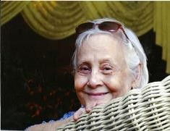
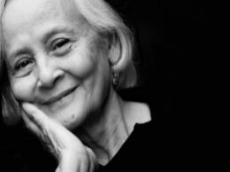

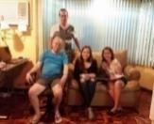


Agripina Rasco Getting more handsome as he gets older. Why is that? Agripina Rasco Ha ha. I was serious when I said that. I suppose because you have a reason to live. May God continue to richly bless you and your family.
Dolores B. Felicitas Congratulations, Manong Frank. Dolores B. Felicitas Hi, Manong Frank. You are a darling to all the students of SSI training them how to plant rice, veggies and fruits. They got this training from the expert on agribusiness and now they are so happy to look at their produce. May God continue to bless you always and give you good health, Manong Frank. Certainly, Nang Femme is smiling and thanking God for sending you to help them. Hugs.
JoAnn de Larrazabal
August 4 at 7:18am · Missing Mommy on her 88th birthday. Always in our
hearts Frank
Francis Gorrez with JoAnn de Larrazabal and 3 others. August 4 at 5:27am · Happy birthday Mom, missing you much
Carol Barlow What a stunning beauty JoAnn
Jennifer Mendoza thank you manong frank for sharing your blessing with SSI family
Daniel Añover Rodriguez with Stephanie Rodriguez Sioson and 2 others.November 8, 2015 · Talking agriculture with the rice master, Grandpa Frank Gorrez...
Dolores B. Felicitas. Nang Femme, what a great contribution you have given to the people in your community and what a blessing to have Manong Frank come to help you with agribusiness. May God continue to bless you with such a very laudable cause. You are a big blessings to the community. Congratulations!
Bonville Bowen Tina Price Your Dad is such an inspiration.... Age has no barriers and Age brings wisdom and knowledge. Proud to know him...
Hi Dad,
You have been a blessing not just to us your family but to many!
With the help of our great God, you have been instrumental in changing the lives of not only the teachers and students but of those that will come after them because you have shared your passion and equipped them with the skills and knowledge that they can pass on to their families.
Love you, Cleia
Kapatagan LGU is a partner of Shalom Science Institute through the invitation Mayor Nhazruddin Maglangit and LGU. It was there that Frank Gorrez, SSI Consultant and BOT member, conducted workshops and distributed free rice (palay) seeds to 84 farmers! Palay seeds were harvested from SSI Rice and Vegetable Garden. SSI is proud to assist the farmers
by giving them There is measureless joy in a bountiful harvest. What SSI has learned from Consultant Dr. Frank Gorrez... plant a seed and harvest comes- is truly incredible. Multi- cropping on a 500 sq m previously a dump site works. New variety of papaya is now introduced in Balabagan. Lanao Del Sur, Mindanao.

Slide 21

Aurora G. Pal-Montano Great Job.
Dolores B. Felicitas I can only guess how happy Nong Frank is with all the smiles looking at all the produce of veggies. Thank you, Nong Frank.
Esther Tellie Amante What do you call that ... second energy? ,,, after Frank had rested for a while, there he goes again!
Frank C. Cornejo There are not so many of us living any longer..how is Dave and Danny ? Fel C. Grine Orly S. Mar Cortez. Tony
Mapa.Lino Yap and of course Rudy Ela. They say beta sigmans never die...they just fade away.
Frank Gorrez Tokayo Frank C. Cornejo Howdy. Dave is in Maryland, Dany joined our maker many years back. I'm still at 85 doing volunteer work in Lanao Del Sur for both Muslims and C ristians.
Frank C. Cornejo What a noble and very rewarding apostolate not surprising for an LB betan but interesting to know how you manage. Must be your theraphy, guided by your guardian angel brod. Take care brod.
----------------------------------------------------------------------
GLOBAL MINISTRIES & UMCOR
Frank:
I enjoyed seeing the work you did in Mindanao.
I give thanks for your dedication and effective work.
May God continue to bless you as you bless others with your skilled service. Jim
James L Gulley jameslgulley@mac.com
Global Ministries and UMCOR Coordinator for Haiti Advisor, Agriculture and Community Development
----------------------------------------------------------
Bing soycaphalf@yahoo.com.au
Hi Everyone
Thanks AFemme for the advice.
Ading & Jen, please note AF's advice below when you hire new teachers. Can you make copies of the Statement of Faith and distribute to all teachers and staff. Also can you ensure a copy is attached to all contracts so teachers are aware of it.
The Lord knows about SSS's situation and we should not be afraid to stand up for our faith. The support SSI has received & continues to receive financially via missions, overseas in particular, is substantial. In addition, the Lord has provided expertise in MFrank to progress RVG, which opened up opportunities leading to more financial & in-kind donations, as well as promoting SSI far & wide. The Lord has touched so many people to take SSI to where it is now.
Thanks Bing
-------------------------------------------------------
Eufemia Tobias Munn
Frank spent 4 days during HoFrank spent 4 days during Holy Week in Balabagan... so very nice of him and we are fortunate to have him do administrative functions in my absence and of my brother Ben, who had just started a new job in Calamba, Laguna. Frank endeared himself to the faculty--- accomplished a lot! He is not only a consultant but also BOT member.

Slide 22


April 30 ·
My thoughts from my porch of "healing haven" take me to thousands of miles away to Shalom Science Institute in Balabagan, Lanao del Sur, Philippines. Enrollment will soon commence. The academic program from kindergarten to Grade 10 in high school is highlighted by the successful agri-business project of Rice and Vegetable Garden (RVG) spearheaded by Dr. Frank Gorrez, consultant and member of the Board of Trustees.. SSI is fortunate and grateful to have him whose efforts have gone beyond SSI to the Muslim community.
School closing is just a step to next school year --- enrollment 7/3/17 K-Gr.10 soared to 292, an all-time high! Ripple effect of Consultant Frank Gorrez work is making a big difference in a school where the sea meets blue skies in endless horizon.
Eufemia Tobias Munn
--------------------------------------------------
From: Jennifer Mendoza (SSI Academic-in-Charge)
21/07/2018. Sa July 21, 2018 manong frank naa pa me buhaton nga tribute kay mam fem kay mao kana ang foundation day sa shalom.I really admire mam femme how strong woman she is manong frank..I am very much thankful that i am part of shalom family because of mam fem kay with her initiative di ko bal an asa ko karon naka work ug daghan ako nakat-unan sa iya manong frank.
Pasalamat pud kita sa ginoo manong frank kay naga increase atong enrolment yearly maskin wala kita scholarship offer sa high school for two year na pero good news kay atong population both elementary and high school increase. Karon nga tuig nag increase atong population total population elementary and high school 312.
Hello manong frank good evening. buwas magkadto kami ni mam ading sa Tacurong sa NDEA main office sa region 12 kay magpasa na kami sa atong application for ESC.
makaluy an ta sa ginoo manong frank dako kaayo na bulig sa skwelahan. pagka maapprove ang ESC lipay gid si mam Femm
--------------------------------------------------------------------
President's Fund
This I created when we decided to have a Consultant for SSI. I prayed for someone to help us and Frank came. It is my personal commitment to let this fund keep going to take care of needs relevant to consultancy. Where the Consultant is concerned, his expenditures are all taken care of. No worries!
Afemme
________________________________________
Thanks for the comprehensive report Auntie Femme. This is the first opportunity I've got to respond to many emails including yours. Very much appreciate the effort of Dr Gorrez in progressing the 3TS via the RGV, and the interests/influence that the initiatives have gathered. Thanks for forwarding the 2 reports.
Manong Frank, hope it is ok with you if I use some of those materials in my promotion of SSI here in Perth/Australia.
A$3,000 in anonymous donations was received thru my church (All Nations Presbyterian Church) between July and September:
$1.5k went towards Oct 15 payroll;
$500 to teachers/staff annual physical examination during the semestral break (end of this month)
1k towards the 1st half of 13th month due in December
Look forward to receiving future updates. Regards,
Bing
From: Eufemia Munn <eppieph2002@yahoo.com> Sent: Saturday, October 22, 2016 5:25 AM

Slide 23
To: W. Llamera; Esther Amante
Subject: Fw: September Rice & Vegetables at Balabagan, Lanao Del Sur
Hi Win and Tellie,
This pictorial report of Frank would be of interest to you, including free arroz caldo to 241 Kindergarten to high school for P1,300 donated by an NGO of Filipino Stewardesses Org of Cathay Pacific based in Hong Kong.
Frank is a God-sent person to SSI! Within 4 months much has been accomplished. The Rice and Vegetable Garden has become a beacon of light, a "Light in the Crossroad", the topic of my Sunday message in Church. The light beams to the community and beyond. Free distribution of palay and vegetable seeds to parents, schools, and farmers in the area has caught like wildfire.
PhilRice gave SSI 8 varieties of upland rice to see which best fits the area. Seeded on July 1, we harvested two varieties last week. The miracle is: 1 seed produces 2,000! A handful seeded on July 1 produced a few kilos of seeds and given free to farmers. This empowers them to plant seeds for multiplication for their use, not dependent on government hand-out.
The beam has lighted on Jomar Lobregat, owner of huge plantation of cassava and coconut. He has started his rice production and a vegetable garden to replicate SSI's is now producing lots of vegetables - first sitao harvest was 17 kilos. He is planting SSI rice varieties (harvested this month) to 1/4 of his one ha. initial rice farm. His goal is rice mass production. The rest of this one ha. is planted with palay seeds that he bought in Midsayap, accompanied by Frank. While there they had lunch at Southern Christian College with its president and Portia Mapanao.
Frank has found his niche and is having a marvelous time teaching, producing, lecturing, gardening, and consulting. It has given him a new zest for living being able to help so many people, Christians and Muslims.
Thank you so much Win, for your generous support of eight 7th graders for tuition and entrance scholarship. Kindly open attachments.
Femme
--------------------------------------------------------------------------------
Great work, Brod! Service and sacrifice; you should be emulated by Betans.
Brod Chito Protacio
Director, Philippines Rice Research Institute Nueva Ecija
-------------------------------------------------------------------------------
Frank,
Domini and I read and talked about the files you sent about Madam Eufemia Tobias. She was a great woman. I am sad to learn about her demise. May she rest in peace.
I am happy and proud of you for your effort and dedication to help students and farmers in Mindanao to learn modern farming.
Hoping to meet you sometime soon.
Apin (Saeed Daof)
-------------------------
Ana Fe Samonte God Bless you Dr. Gorrez for all that you have done to SSI and to the community in general...my love to my Lanao folks.
Frank Gorrez Appreciate your kind words. I'm doing what are possible to help these loving communities. It's payback time for me.
Eileen Bennett Awesome. .Hi Mr G...You're looking younger everytime I see your pic
Frank Gorrez You make me blush. I'm a grand pa & addressed as AMPA by everybody. Thanks anyway.
Genel Rivera Go go go Uncle Frank!
Kit Palabyab Safe trip Grandpa Frank Gorrez! praying for your successful trip! you are a blessing to that community! <3
Matias Garcia Jugo Very happy and proud for you all.

Slide 24
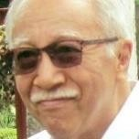
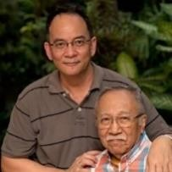
Evelyn Bobby Manzanero HI JOANN SUPERBILIB AKO SA DAD MO! I MISS HIM IN AS MY NEIGHBOR ADMIRING MY SIMPLE PLANTS HERE IN THE VILLAGE. LONG LIVE YOUR DAD FOR HIS DRIVE TO HELP THE NEEDY. YOU ARE SOOO BLESSED HAVING HIM!
Melissa Ylanan Moran Your dad is my idol!
Bonville Bowen Tina Price What an amazing man.. I hope I have his energy and enthusiasm when I reach his age.... Love and God bless Frank
Jules Dela Fuente Praying for your health and safety Tito Frank. Denise M. Weldon What wonderful purpose JoAnn!!!
Cecile Maica Fernandez Such a blessing to have a dad like him! Jon Jena God be with you Uncle Frank.
Betsy de la Fuente I love you, Tito Frankie! What a wonderful inspiration you are of love and faith to all of us! Praying for you!
God bless and keep you!!!!
Johnny Ventosa The energy, the dedication but it is really the enthusiasm (entheo) that encourages him--kudos
Germelina Lising Salumbides I enjoy your posts about your Dad... truly a kind , energetic, committed, gentle scientist . We should all be so lucky to have passion for the things/ people we love - like he does. I am hoping when I grow up I could be like him
Isabella Gorrez Go gramps
Mina Lim Garcia Awesome!
JoAnn de Larrazabal THANK YOU ALL, FOR YOUR BEST WISHES & KIND WORDS FOR DAD. HE IS SPECIAL
Lilia Cipriano-Conejos You're so Blessed to have your Dad with you :). Looks healthy & very inspiring to be doing a lot for the Filipino people.
Cynthia Servida-Mejia Galing talaga ni Tito Frank. Good luck Tito. Hugs Jong.
Yek Noel Thank you Tito Frank for serving the least of our brothers and sisters. May God bless you! Rosa Maria M. Chua Awesome and truly admirable. God bless you Tito Frank.
Charity Llorente Paraguas Bulanan You go Uncle Frank!
Cleia Gorrez Our love and prayers are with you, Dad. Keep safe
Cita Aguado Schmid Amazing JoAnn may Papa Dios continue to bless him!
Bong MN More power and God bless, Tito.
Esther Tellie Amante Go go go. Frank ... praying for good health and protection and wisdom as you continue your ministry in life! May the attached picture of your younger days with Eppie inspire you more!
Cesar de la Fuente I so admire my Tito Frank. You are an inspiration to me. love you
Lina Basas Machon God bless you with good health always granny...... Brenda Rana Parducho Ramos Wow amazing!
JoJo Calma Lazaro Idol
Katherine Zavala Wong More power to you to Tito Frank. I hope to be able to visit you. Especially since I will be retiring. 500 sq m plot turned into lush green landscape.
Esther Tellie Amante ara dira si Frank? God bless your endeavors, folks.
Eufemia Tobias Munn He took the picture. He is not only a master gardener, a task master, but an excellent photographer with an eye from turning dry soil into lush green plants.
Eleanor Funda-Sardual What a "refreshing" photo this is... Happy for Shalom and God bless Frank's influence...
Frank Gorrez Thanks Eleanor. Your friend Femme is an excellent student and teacher in agriculture after six months of daily exposure with me planting/seeding
rice (palay) and different vegetable varieties. Regards, Frank Gorrez
Eleanor Funda-Sardual It takes an excellent teacher to grow a student w/ excellent potentials, I say, haha... good morn Frank and Shalom.
My favorite son Francis living in Sydney with family. Edilyn Tarorochi sir frank kumusta,mao na im0ng anak sir?
Mar 9, 2017, 6:34 AM
Try stepping out of your comfort zone targeting to help others with experience that you were equipped to have developed in your life time. It's emotionally and spiritually uplifting trusting our Lord as your mentor.

Slide 25
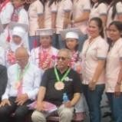
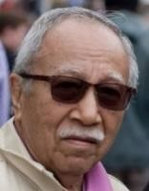
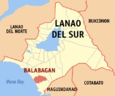
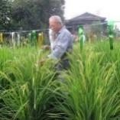
Asper Enero Pacute ba si nong Frank hehheje
Jennifer Mendoza he is the grandfather of SSI..thank you for sharing your wide experience & knowledge manong frank.. Mirriam Gorrez Still looking gwapo tito! MisS you!!!
Frank C. Cornejo What a noble and very rewarding apostolate not surprising for an LB betan but interesting to know how you manage. Must be your theraphy, guided by your guardian angel brod. Take care brod.
Cristy Hofer That's what green thumbs do daw Tito Frank.
Esther Tellie Amante hahaaah....such camaraderie touches my heart! Makabuhi sa dugo!
Guest Speaker Dr. Frank Gorrez (black shirt) in the Completion Ceremony of SSI Students...... April 2017. Frank Gorrez Grade 10 Completion Ceremony Speaker.
Dakoy Gorrez You are rocking it Tito/Brod Frank! Much love! Mirriam Gorrez ayyyy! Gwapo!
Jules Dela Fuente You’re still so guapo Tito Frank.
Guest speaker in SSI-Comletion ceremony for grades 10, Lanao Del Sur, April 2017.
Mirriam GorrezHello handsome!!!
Rosette GorrezHi Tito! Looking really good! Love from all of us here
Marcelo Aspiras Brod Frank, mine is marsaspiras@gmail.com. We really have to do a lot of catching up after more than half a century since we last met, if I remember correctly at IRRI when I as with the IRRI's first batch of Research Scholar in early sixties.
Frank Gorrez You are correct. I was at IRRI 1965 to 1970 and started getting out of the country almost continuously for 45 years
as a private rice/etc consultant. The story goes on …. I'll send you my Mindanao Chronicle.
Sam Buot Ayaw pa lupig. Sila na lang? Esper Enero God bless nong Frank
FDGorrez first direct seeding of 8 rainfed rice varieties in the RVGarden of Shalom Institute, Balabagan, Lanao Del Sur, July. 2016. Transfer of Technology started from 1) requesting PhilRice to provide rice rainfed seeds, 2) implementing a rice production and multiplication program through the school program involving students and teachers, 3) then adoption of technology with seeds distribution to the farming community. IT TOOK FOUR (4) MONTHS TO SHOW RESULTS AND FARMER’S ACCEPTANCE IN TWO MUNICIPALITIES IN MINDANAO.
Sam Buot Apropos with him in the middle of a rice field.
Frank Gorrez Wala patubig o irrigation ang rice crop has convinced the mayor of kapatagan, mindanao it's what they need. Adlai Amor Let’ make it a point to meet for lunch or dinner when you visit your children.
Frank Gorrez Growing rice under rainfed condition in Shalom Balabagan, a hands-on implemented project by students and teachers of the school. Shown is a map of LANAO DEL SUR (red colored area), MINDANAO (Region XII), where Frank Gorrez volunteered through a Christian school in the Municipality of Balabagan implementing a "Rice & Vegetable Garden" (RVG) for Grades 9 & 10 as required by the Dept. of Education.
Esther Tellie Amante "The glory of young men is their strength; and the beauty of old men is the gray head." -Prov. 20::29 I guess that includes the mustache and the eye brow. Betsy de la Fuente Handsome! God bless you! Hugs! Love you much, Tito! Beatriz Mete, you have such a big heart and always think of others, take care of yourself too dad.
Nico Bauer Lookin fly umpa Frank Gorrez. Love you Nico.
----------------------------------------------------------
Marilyn Chan (Cambodia) Happy New Year!
Jennifer Mendoza advance happy new year manong frank..father of shalom..we mis u manong frank. Belen Carrasca Tobias You're like a Santa Claus uncle frank!
Marilyn Chan Are you in Cambodia right now? We miss you very much?
Frank Gorrez No Marilyn. These are old pictures when I visited you & Joseph. I missed both of you as well. Marilyn Chan Oh, I thought if you are here Joseph can bring you around in Siem Reap
Belen Carrasca Tobias Hello uncle Frank,I wish to see you again here in balabagan,, Frank Gorrez God willing I'll be back one more time with HIS blessings. Pray for it.

Slide 26


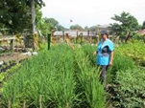
Aida Padua,
Cathay Pacific, Hong Kong.
I recommend this Institute because of its advocacy to teach farming back to the youth..... the school is a multicultural diversity where students fr different cultural, and spiritual leanings come together to learn farming. Tito Frank, one of its consultants is a retired executive scientist from IRRI and is sharing his knowledge to help this Institute.
April 17
Nestor C. Marquez Good work brod. Cheers
Mike Olo Mabuhay ka brother Frank !!! Cheers !!!
Butch Madarang Brod Frank, are you based in lanao DS. If yes, are you interested in making productive and share profits with a tiger prawn farm we have in Lala,Tubod, Lanao del Norte. it can be with Gawad Kalinga or any school involved in one of your programs. If yes, PM me. Cheers!
Edgar Largo Saludo brod ako sa iyo! God bless & more power to you!!!
Rogelio Danao I doff my hat to you, Broder, for this very noble undertaking! Cheers!! Cheers!!! Richard Archie Jornadal Glory Beta Sigma! Cheeeers
Dominic U Abalos Cheeersz to you Brod...ur noble deeds are indeed worth emulating... Darwin V. Igualada Mabuhay ka Brod. Frank!
Michael Ilano Salute to you Big Brother...
Gilmar Taebas Cheers brod Frank
Rene Renato Tiamzon Good job! Cheers!
Ramon Zafra What a great endeavour. How I wish to reach such age. Cheers brother.
Danny Peralta Mabuhay ka Brod. We love Mindanao.
Noli Santua Jr. Noteworthy, cheers brod doc frank! Ed Baldoria Cheers Brother. God bless you.
Elijah G. Lorenzo Cheers Brother! Proud Brod here!
Rob Zinampan Nice work
Romeo Boñaga Live Long Brother!!!
Manuel Serrano Cheers brother. Keep it up. Congratulations!
---------------------------------------------------------------------------------
Francesca Araneta Dear Frankie. Congratulations for having found your niche with a community whom you serve and with whom you shared everything that you know. Their self sufficiency in producing their own food will last a lifetime., and must be so rewarding. This has always been your mission. I want you to know that I am so proud of what you’re doing and that I pray that you will continue to widen your influence to other communities for as long as you are able. Love, Ate Lydia
Jules Dela Fuente Im proud of you Tito Frank.
Maya Gorrez You are always amazing, Tito Frank! Love and miss you.
Cynthia Servida-Mejia So inspiring Jong. Congratulations Tito Frank, more power to you!
Lorna Rodriguez So proud of uncle Frank!👍👍👍
Olive Hafenstein JoAnn, when I read your post, immediately this piece of scripture came to mind... "They will still bear fruit in old age, they will stay fresh and green..."
Psalm 92:14
----------------------------
Redempta Hofer Rivera, Registrar & Treasurer of SSI enjoying the rice crop. 2016. Manong, thank you very much for stablishing the RVG at SSI, We miss you
Frank Gorrez Psalm 139:13-16: For You formed my inward parts; You wove me in my mother's womb. I will give thanks to You, for I am fearfully and wonderfully made; Wonderful are Your works, And my soul knows it very well. My frame was not hidden from You, When I was made in secret, And skilfully wrought in the depths of the earth; Your eyes have seen my unformed substance; And in Your book were all written The days that were ordained for me, When as yet there was not one of them. (My Trust & Faith in My Lord).

Slide 27

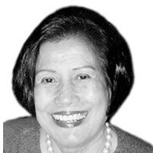
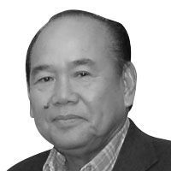
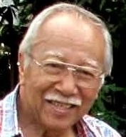
I recommend this Institute because of its advocacy to teach farming back to the youth..... the school is a multicultural diversity where students fr different cultural, and spiritual leanings come together to learn farming. Tito Frank, one of its consultants is a retired executive scientist from IRRI and is sharing his knowledge to help this Institute. (Aida de Padua: Hong Kong based – Filipino/Cathay Stewardess)
----------------------------------------
In April-May 2017 in the midst of the ongoing Marawi war, Mayor Nhazruddin Maglangit, Al Hadj with his agricultural staff in Kapatagan municipality, Lanao del Sur, visited SSI and invited Frank to extend the SSI-3TS Development Program Assistance to 15 barangays of Kapatagan, under his administrative jurisdiction. There Frank, then SSI consultant and Board of Trustees member, conducted workshops and distributed free rice seeds to 84 farmers. Palay seeds were harvested from SSI’s Rice and Vegetable Garden. SSI felt proud to assist the farmers by giving them free seeds. Then Frank conducted a seminar-workshop in the municipality of Tajah Buayan, Maguindanao under the sponsorship of Gawad Kalinga/Konomics, on March 22-24 this year.
Reported SSI – Pres. Eufemia Munn: “Shalom Science Institute’s RVG is bridging the gap between Christians and Muslims through students’ participation, community awareness, free distribution of palay and vegetable seeds. We at SSI are very fortunate and grateful to Frank Gorrez, who, like a stone dropped in a pond, ripples of his work are reaching out to the needy and to a local plantation owner.”
(Excerpt from PhilStar Domini Torrevillas)
__________________________
    Rey Gamboa (Excerpts from The Philippine Star) - October 11, 2018 - 12:00am. Read more at https://www.philstar.com/business
Dr. Frank D. Gorrez, PhD, an agronomist who graduated from UP Los Baños, shares with us a farming syllabus that he helped develop with the Shalom Science Institute for teachers, students and farmers in Banago, Balabagan, Lanao Del Sur, Autonomous Region of Muslim Mindanao.
The syllabus, which he called Training and Technology Transfer System or 3TS, was to comply with a requirement of the Department of Education for senior high school students. It was started in 2016, and nurtured until 2018 until it was sustainable.
The 3TS program that Dr. Gorrez helped develop is a reminder of the immense role that the educational system can contribute to encouraging our students to appreciate the value of agriculture, while at the same time taking a more active role in the community by bringing new technologies to the local farmers and households.
Senior high school students in barrios and rural towns have a better affinity to the land that their counterparts in the cities do and because of their age compared to their parents (or grandparents), will be more inquisitive and receptive to understanding and trying out new technologies.
----------------------------------------
Helping the very small farmers are not always efficiently accomplished like those with conditions existing in Lanao Del Sur, considered as one of the poorest province in Mindanao, Philippines.
Much of the vital information does not reach the extension workers, other agencies, and specially farmers because there are not enough people trained to implement development programs. “Transfer of Technology” do not exist. Our target clientele here are the hand-to-mouth, back yard size farms (less than one hectare) who just need to feed his family and can never afford to commercialize his endeavor.
See the attached or request the Photo-Journal, titled The SSI-3TS-RVG Chronicle that was implemented in Lanao Del Sur. gorrez.frankd24@gmail.com.

Slide 28

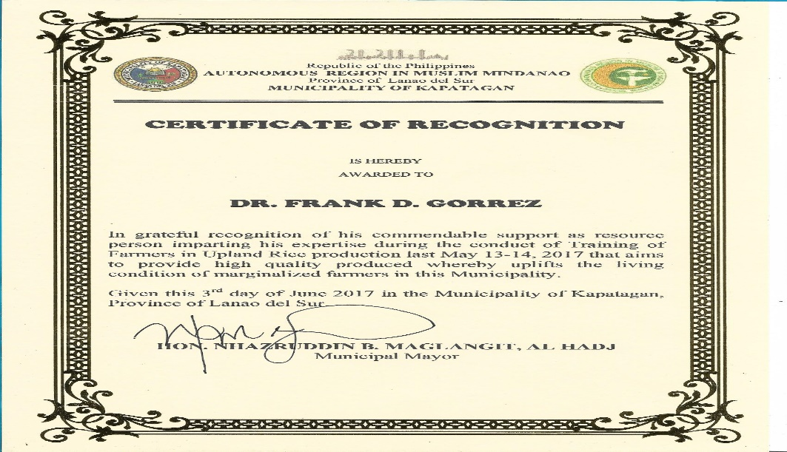
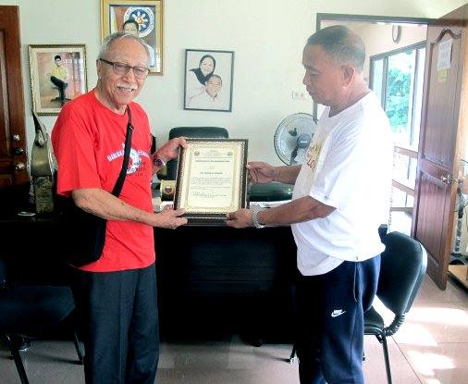
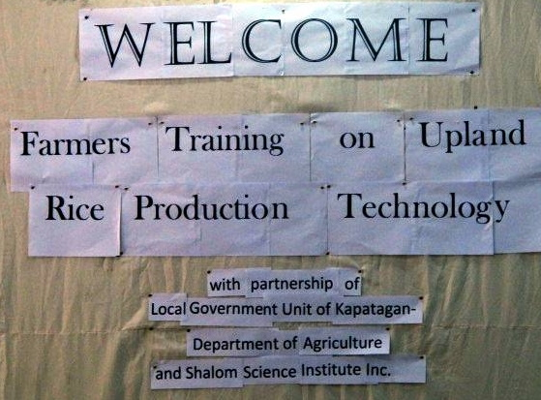
Ravindra Joshi
Ravindra Joshi Congratulations Frank Gorrez. There is a lot to learn from you for young generations. God bless.
Delete or hide this
Like
· Reply · 15w · Edited
Ravindra Joshi
Ravindra Joshi Congratulations Mr. Frank Gorrez. Your Global Agriculture experience and sharing it to Filipinos is excellent. God bless you. Regards. Ravi Joshi
Eufemio Rasco
Eufemio Rasco Carry on brod. You are doing very well!

Slide 29
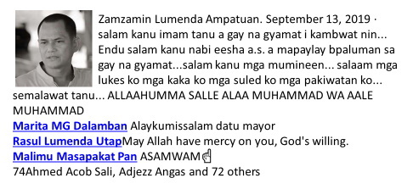
Belen Carrasca Tobias Geno was harvesting squash, were happy to see that, ang dami basketful,, i told him mgbili aq geno ha, and he replied cge antie hatiran lng kita,, and binigyan talaga aq,,
We are so grateful for having uncle FRANK GORES, the real father of Shalom family, whom so sincere and thoughtful to his children.. Wwe love you uncle frank missed u much,
Ravindra Joshi Frank you have great passion and commitment. God bless.
1Mar 2020
Frank this great!!! This will really benefit not only school children but communities around the school. DA should look into this kind of project.Bong Bolo
Frank, we are preparing a project to establish Modern Rice Farms in a number of places. Each site will cover 100 hectares. I wonder if. You would like to take some time to help as a coach to the farm manager of one of these farms. Bong
Arnel Colina nong frank,it was our boy/girl scouts in upper itil elementary school who once visited your vegetable garden
Frank Gorrez Arnel, thank you for sharing.I will always cherish their/your visit as they learned more about agriculture. Blessings to you, all.
Arnel Colina thanks nong frank,it was such a delightful garden tour as the scouts gain knowledge in proper gardening

Slide 30
On Nov 15, 2019, at 6:51 AM, Frank D. Gorrez <gorrez.frankd24@gmail.com>
Ben III Malayang comments: wrote
Catch fisheries are in trouble worldwide. And if seas and oceans continue to acidify and hear up (these have been measured to be increasing on average worldwide), culture fisheries would be our viable option. And given our scarcity of lands less likely to be affected by either sea level rise or salt water intrusion (both happening now), incorporating and/or doing in tandem culture fisheries with agronomy would increasing become an imperative. Besides, water holding such as with ponds would be an increasing necessity in the face of more frequent episodes of extended drought and wet seasons (as has been also happening in recent years).
This is just my take.
Thank you very much, 'Nong Frank, for sharing these pretty pictures of the Shalom Science Institute (SSI) Rice and Vegetable Garden (RVG), which provides an undeniable testimony of your accomplishments there, despite the brevity of time that you and our dear Ate Femme worked together. These pictures and some write-ups about your work there, speak tons of what you did and how much you have contributed to what SSI symbolizes and what it is today.
During our last visit in 2016, we had the golden chance of seeing the corner site of the RVG. We were so amazed that such a small space could contain such abundance and variety of rice and various kinds of robust vegetables! Surely, what you did to SSI would be beyond what Dr. and Mrs. Merton D. Munn conceived and imagined when they established such institution in order to help many less fortunate children in the community: to be able to read and write, to proceed with further education, and to "bridge the gap" especially between the Muslims and the Christians in the community. The program has become an example and a model that has attracted many farmers and government administrators in neighboring towns and provinces. Surely, Ate Femme and "Big Brod (Mert)" are smiling with pride and gratitude in heaven. Thank you and God bless you always.
Rachel T.* (and Gideon Z.) Alegado
*Younger Sister, Official Representative, and Acting CSI President

Slide 31
Jomar Arciaga 1:44 PM, March 14, 2020
Malmon po ako and i read alot of stories about your noble projects and ccomplishment in agriculture (Rice production, farming etc.) It is really remarkable and a big help to our farmers, to our filipino people and to our country. Mabuhay po kayo Brod Doc Frank.
Dear Dr. Frank Gorrez:
Thanks a lot for compiling the revealing photos of the gardens of the Shalom Science Institute in Balabagan. What these gardens give you—vegetables and root crops—are very good food sources to the people of your school, town and surrounding areas.
From the standpoint of scientific nutrition, these foods are healthier for the consumers because they have no fatty components and they are rich in vitamins, minerals, antioxidants, carbohydrates and fiber.
Vegetarians and those who eat more vegetables than animal-sourced food items are healthier than meat-consumers in the long run. They have longer life spans than the others. Several articles in medical and nutrition journals show why consumers of non- or low-fat foods are healthier: they have lower incidence of high blood pressure, heart disease, M. I. (heart attacks), strokes, diabetes, and blood vessel clogging.
That is why the general population should be educated to be consumers of more vegetables and non- or low-meat consumption in their daily eating habits.
Congratulations and thanks to you, Dr. Frank, for your great contributions to the Shalom Science Institute (SSI) in their administration and cultivation of their green projects!
Eusebio C. Kho, MD
Scottsburg, Indiana, USA

